Slide 1
IT’S TIME-PUSHING THE ENVELOPE: CENTERING RACIAL JUSTICE IN CIVIL LEGAL AID ADVOCACY
JANET CHUNG
COLUMBIA LEGAL SERVICES, SEATTLE, WA
ROBBIE MCEWEN
NEBRASKA APPLESEED CENTER FOR LAW IN THE PUBLIC INTEREST
LINCOLN, NE
MODERATOR:WEAYONNOH NELSON-DAVIES
COMMUNITY LEGAL AID, WORCESTER, MA
JULY 22, 2021

Slide 2
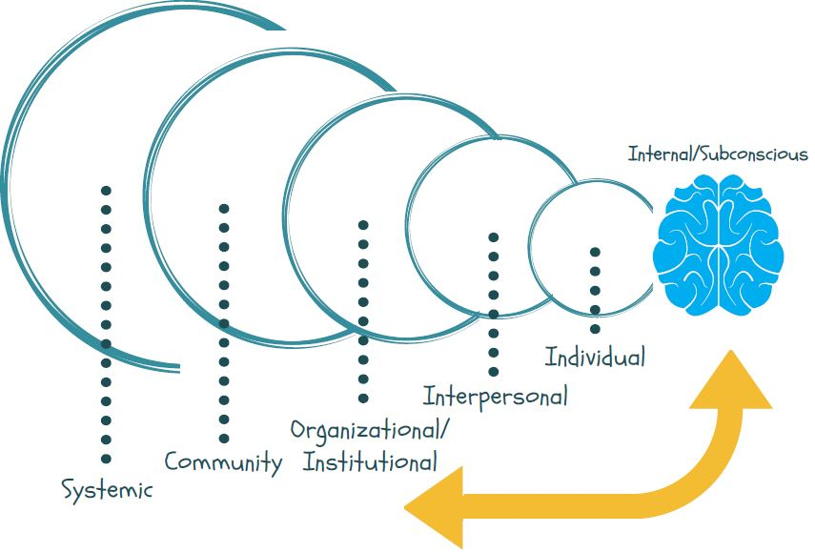


The Five Levels of Race Equity Work
Notes:
ALL LEVELS IMPORTANT. To discuss race equity, or any issue related to equity across race, class, gender, we must build our understanding and analysis across the levels.
Our internal subconscious affects all the levels. We are individuals who interact with all these levels
Today, we start with Internal/Individual (IAT, brain), Individual/Interpersonal/and up (Nieto), an then how it affects up to other levels.

Slide 3

ORGANIZATIONAL CHANGE
ON A CONTINUUM
Understanding of systemic racism with no fundamental shifts in power
Tokenism, limited number of people of color
Rare.
Intentionally excludes people of color
Open calls and communication for diversity with people of color in non-leadership roles
Using racial equity approach in all decision-making; intentional hiring and leadership development of people of color;
Shift in power with community partners
Source: JustLead Washington. Adapted from “Continuum on Becoming an Anti-Racist Multicultural Organization”© Crossroads Ministry, Chicago, IL. Original concept by Bailey Jackson and Rita Hardiman, and further developed by Andrea Avazian and Ronice Branding; further adapted by Melia LaCour, PSESD.

Slide 4
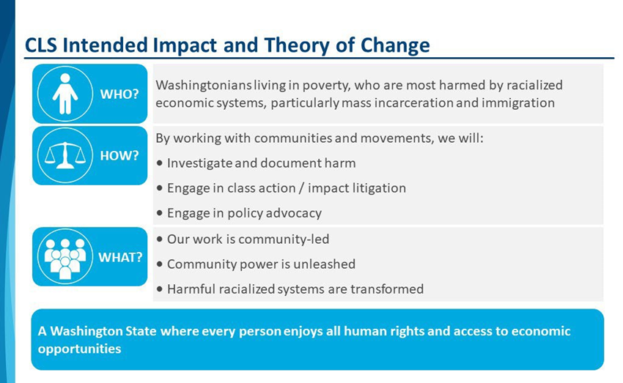

Slide 5
CLS Community Engagement Continuum

Slide 6
Race Equity Impact Assessment
Project:
Assessment Area | Key Questions to Answer | Answers | Key Next Steps
Identifying affected groups and individuals | What racial/ethnic groups are most affected?
 | Other identities that are impacted?
Engaging affected groups/individual s | Have individuals/groups from different racial/ethnic groups been informed, involved, and represented in the development of the project, and if so, how?
 | Have individuals/groups with other identities been informed, involved, and represented, and if so how?
 | How can missing affected individuals/groups be engaged?
Identifying and documenting racial inequities | What individuals/groups are most advantaged and disadvantaged by the situation?
 | What other identities are advantaged/disadvantaged by the situation?
 | How are groups affected differently?
 | What quantitative and qualitative evidence of inequality exists? What data is missing or needed?
Examining the causes | What factors may produce/perpetuate racial or other inequities associated with this issue?
 | How did the inequities arise and are they expanding or narrowing?
 | How can this work affect root causes of the problem?
Clarifying the purpose | What does this work aim to accomplish?
 | Will it reduce disparities/discrimination?
Considering adverse impacts | What adverse impact could result from this work?
 | Which racial/ethnic groups could be negatively affected? What other identities could be negatively affected?
 | How could adverse impacts be prevented?

Slide 7
Advancing equitable impacts | What positive impacts on equity/inclusion may result from this work?
 | What racial/ethnic groups are may benefit? What other identities may benefit?
 | Are there additional way to maximize equitable opportunities/impacts?
Examining improvements | Are there different ways to reduce racial disparity and advance racial equity?
 | Are there different ways to reduce disparity for other affected groups/individuals?
 | What parts could be revised to ensure positive impacts on equity and inclusion?
Ensuring viability and sustainability | Is the work realistic (funded, equipted with mechanisms to support the success of the work)?
 | Are there techniques to ensure on-going strategies which support the work (ongoing data collection, public reporting, participating of affected groups, public accountability)?
Identifying success indicators | What are the success indicators and progress benchmarks?
 | How will impacts on equity and inclusion be documented and evaluated?
 | How will ongoing engagement of affected groups/individuals be assessed (level, diversity, quality)?

Slide 8
RACIAL EQUITY IMPACT
NEBRASKA APPLESEED
ASSESSMENT GUIDE
This Guide should be used to anticipate consequences, assess strategies, and strengthen our work with diverse groups and individuals. It should be used during the decision-making process, prior to taking on new actions or work, and on an ongoing basis. Please use for all potentially impacted groups and individuals, considering race, ethnicity, gender, ability, sexual orientation and more.
I D E N T I F Y I N G A F F E C T E D C O N S I D E R I N G A D V E R S E
G R O U P S / I N D I V I D U A L S
With what we know right now, which racial/ethnic groups may be most affected by and/or concerned with the issues related to this work?
Are there other identities that are impacted by this work?
I M P A C T S
What adverse impacts could result from this work? Which racial/ethnic groups could be negatively affected? Which other identities could be affected?
How could adverse impacts be prevented/minimized?
E N G A G I N G A F F E C T E D
A D V A N C I N G E Q U I T A B L E
G R O U P S / I N D I V I D U A L S
I M P A C T S
What positive impacts on equity/inclusion may result from this work?
Which racial/ethnic groups may benefit? Which other identities may benefit?
Are there additional ways to maximize equitable opportunities/impacts?
Have individuals from different racial/ethnic groups been informed, involved, and represented int he development of this work?
Have individuals from other impacted identities been involved?
How can any missing affected groups/individuals be engaged?
I D E N T I F Y I N G &
E X A M I N I N G
D O C U M E N T I N G R A C I A L
I M P R O V E M E N T S
I N E Q U I T I E S
Which racial/ethnic groups are currently most advantaged/disadvantaged by the issues being addressed?
What other identities are advantaged/disadvantaged by the issues being addressed?
How are groups affected differently?
What quantitative and qualitative evidence of inequality exists? What data is missing or needed?
E X A M I N I N G T H E C A U S E S
What factors may produce/perpetuate racial and other inequities associated with this issue? How did the inequities arise? Are they expanding or narrowing?
How can this work address root cause?
Are there different ways to reduce racial disparities and advance racial equity?
Are there different ways to reduce disparities for other affected groups/individuals?
What parts could be revised to ensure positive impacts on equity and inclusion?
E N S U R I N G V I A B I L I T Y &
S U S T A I N A B I L I T Y
Is the work realistic (i.e., funded, equipped with mechanisms to support the success of work)?
Are there techniques to ensure ongoing strategies which support the work (i.e., Ongoing data collection, public reporting, participation of affected groups/individuals, public accountability)?
I D E N T I F Y I N G S U C C E S S
C L A R I F Y I N G T H E
I N D I C A T O R S
What are the success indicators and progress benchmarks?
How will impacts on equity and inclusion be documented and evaluated?
How will ongoing engagement of affected groups/individuals be assessed (i.e., level, diversity, quality)?
P U R P O S E
What does this work aim to accomplish? Will it reduce disparities/discrimination?
Racial Equity Impact Assessment Guide orginially developed by Race Forward

