Slide 1
Community-Driven Movement Lawyering: Equity in Engagement
“Building at the speed of trust… Unknown
At CLS, our aim is to support, protect and defend the rights of black and brown partners and impacted communities. We employ the Anti-Racist Organizing Principles to guide and inform our engagement as we seek to shift power to community and support expanding its capacity to harness that power. This presentation is intended to give an overview of our engagement lens in hopes of sharing insight into how we at CLS view our partnership with client communities.
Overview

Slide 2
Goals
Enhance understanding of Community/Movement Lawyering
Distinguish between traditional lawyering and community and movement lawyering and abolition
Identify how to build and sustain meaningful relationships and how to develop advocacy out of these relationships
Enhance performance, productivity and service to the organization, clients, communities served, and stakeholders.
Cultivate skills and talent through support and coaching
What?

Slide 3
Objectives
Define Community Lawyering, Movement Lawyering, abolition, accountability and the concept of community
Analyze what it means to be community-led
Discuss and workshop the framing for CLS’ engagement model
What?

Slide 4
What is community/movement lawyering?
Why is it necessary?
What is our role in community and the broader movement?
How do we support grassroots organizing, power shifting and power building?
How do legal strategies fit alongside other social change strategies?
Explorative Questions

Slide 5
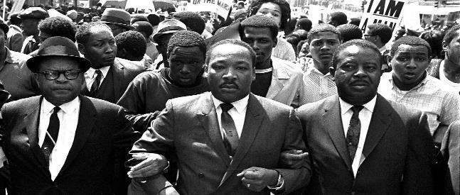
Why?
Why Community/Movement Lawyering?
We’ve got to understand people, first, and then analyze their problems. If we really pay attention to those we want to help; if we listen to them; if we let them tell us about themselves—how they live, what they want out of life— we’ll be on much more solid ground when we start planning “our action,” “our programs,” than if we march ahead, to our own music, and treat them as if they’re only meant to pay attention to us, anyway.
— Martin Luther King Jr.

Slide 6
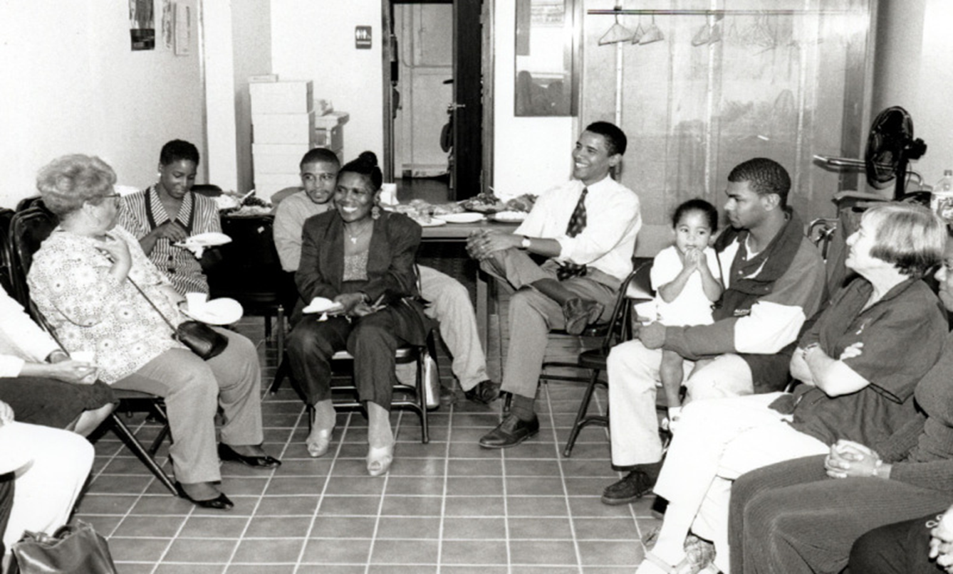
Community lawyering is a "process through which advocates contribute their legal knowledge and skills to support initiatives that are identified by the community and enhance the community's power.”
- The Striver Center on Poverty Law
Community Lawyering

Slide 7
Movement Lawyering is lawyering that supports and advances social movements, building and exercise of collective power and is led by the most directly impacted, to achieve systemic institutional and cultural change.
Movement Lawyering efforts seek to achieve social change through Grassroots activism, organizing and coalition building around social, racial, gender and economic justice as a part of support, empowerment and magnification of community efforts
Movement Lawyering

Slide 8
“Abolition refers to the practice and preparation for a world in which we prioritize collective care, safety, health, and happiness of every single person and reorient ourselves around this priority...”
“…Modern abolitionists see it as our mission to provide the models of community safety, security, mutual aid, and harm reduction that are needed, and to do the political education, relationship-building, and movement work to bring others into demanding transformative economic and social change for abolition.”
- Mon M, Abolitionist
Abolition

Slide 9
COMMUNITY LAWYERING | MOVEMENT LAWYERING | Abolition Principles
Specifically supports the needs of a community/neighborhood | Not limited based on geography | Focus on building mutual aid to minimize dependency on a system
Often focuses on change for a specific geographic location or neighborhood | Focuses on systemic change for the system as a whole | Focuses on reallocation of resources (i.e. facilities, financial resources) to avoid reestablishing the same problematic system
Supports relief for the identified community and is tied to broader abolition work | Relief is much broader with a goal of ending a bad practice. and providing alternatives (abolition) | Relief is found in alternatives to oppressive systems.
Usually tied to the specific needs of the community as a part of the broader cause | Is often less specific and ties into other intersectional movements | Focuses on closing the door to paths that lead to institutional oppression. (Repurpose)
Community Lawyering

Slide 10
Community
Lawyering (Equity/Anti-rasim)
Movement
Lawyering (Systemic Lens)
#OneCLS Model
Abolition
The #OneCLS Model

Slide 11
Analyzing Power | Developing Leadership
Gatekeeping | Identifying and Analyzing Manifestations of Racism
Learning from History | Maintaining Accountability
Networking | Sharing Culture
Undoing Internalized Racial Oppression | Undoing Racism®
Community Engagement Principles
Anti-Racist Organizing Principles: The People’s Institute for Survival and Beyond

Slide 12
Vulnerability – Willing to be challenged and/or relinquish comfort (Comfort in discomfort) = Creates Connection
Accountability – Willing to be humble/humility = Holding Impact and Intent
Consistency – Willing to be Committed/Intentional = Dependable
Trust – Willing to be open = Invested in the collective
4 Keys to Community Lawyering

Slide 13
Community partner voices/input are essential in all advocacy.
CLS’ advocacy is a small part of broader movement and is secondary to, yet in sync with the political activism of a movement.
We work in partnership. Lawyers provide support for the community rather than supplanting community efforts.
We are experts on the system and those most impacted are experts on their conditions and experience and have valuable insight into relief and strategy.
The focus of our partnership is relational and not transactional.
CLS has an anti-racist approach to systemic change.
Avoid viewing lawyering through a “wins” and “losses” lens
Tip for Engagement

Slide 14
Questions and Discussion
Questions?

